Slide 1


GC Blueprint Networking
Duy Huynh – Azure TSP
Notes:
Turn your idea into a new app, reimagine an existing system, or create a hybrid cloud application with confidence, no matter the platform or where you are on the journey to the cloud.

Slide 2
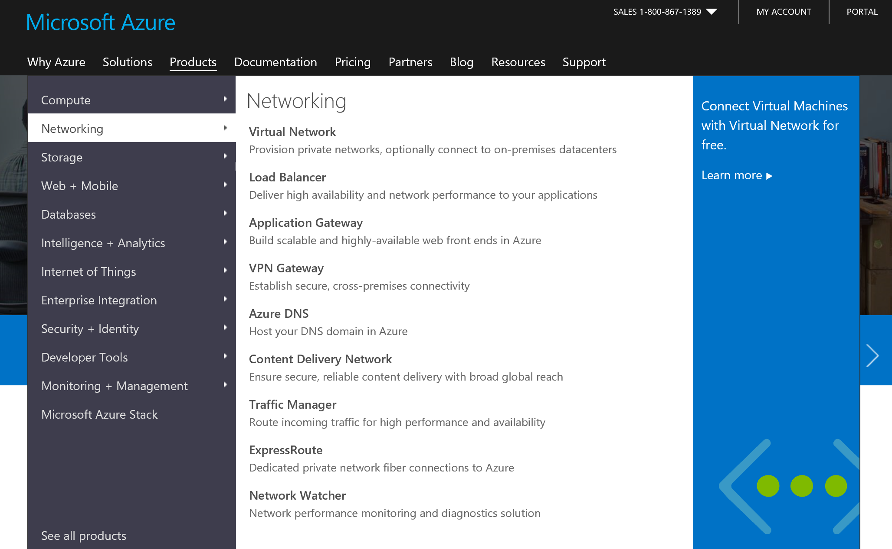
Azure Networking—Services
Notes:
Azure Networking is a suite of 9 services currently. Really a “toolbox” that enables customers to build connectivity to and through the Microsoft Cloud, and create virtual data centers.

Slide 3
Virtual Network
Isolated, logical network providing connectivity for Azure Virtual Machines
User-defined address space (can be one or more IP ranges, not necessarily RFC1918)
1. Connectivity for VMs in the same VNet
2. Connectivity to external networks/on-prem DC’s
3. Internet connectivity
(outbound allowed by default, inbound blocked)
Internet
3. Internet
Name: VNet1
Address space: 10.57.0.0/16, 10.66.0.0/24
2. On Prem
VM
1. Intra-VNET
VM

Slide 4
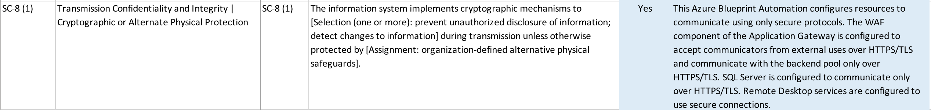
Compliance

Slide 5
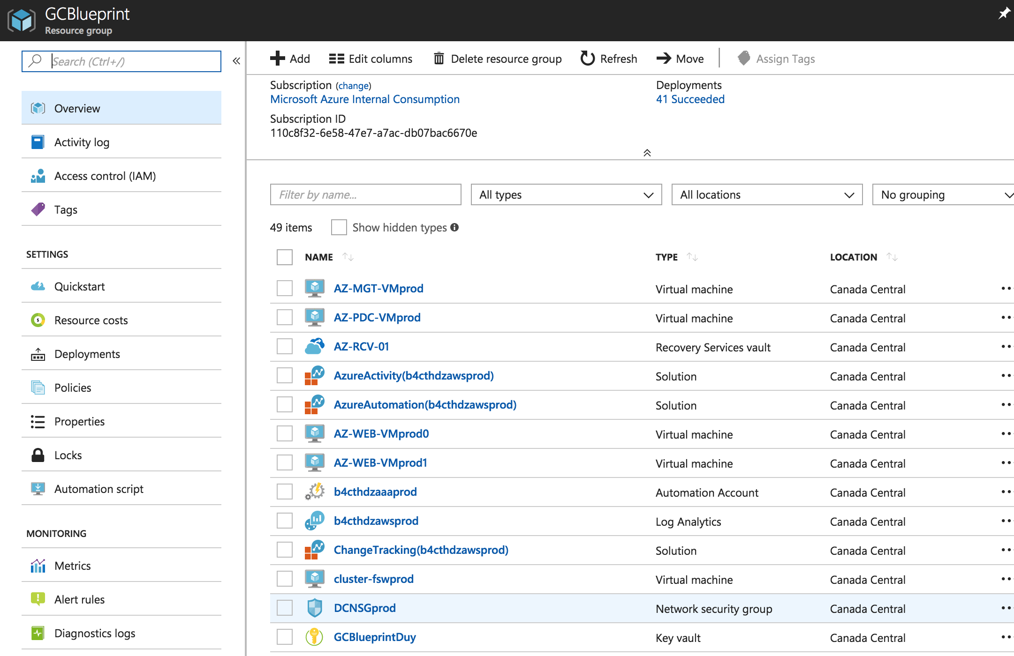
SC-7 (5) Deny by Default

Slide 6
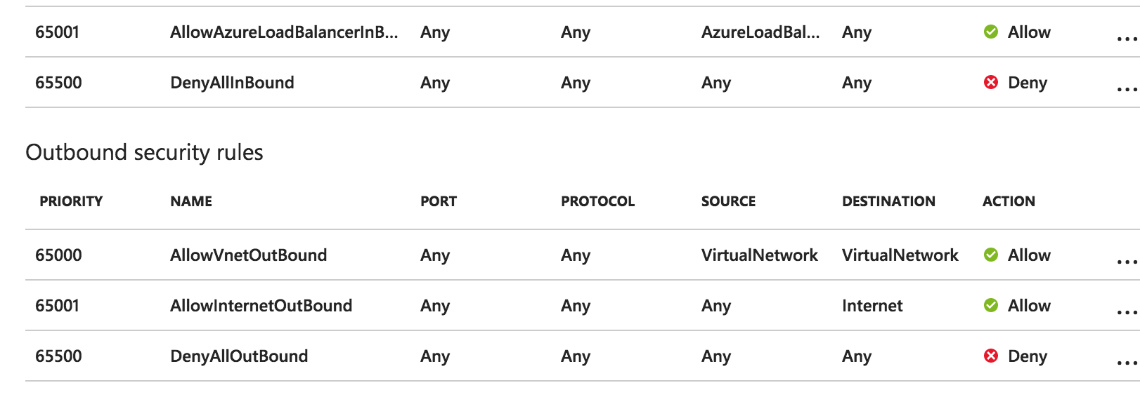
SC-7 (5) Deny by Default - 2

Slide 7
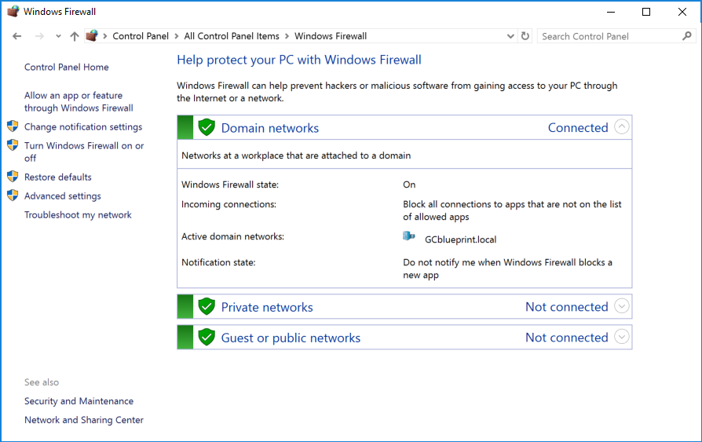
SC-7 (12) Host-Based Protection
Enabled by Windows Server by Default
RDP Into the Machine →

Slide 8
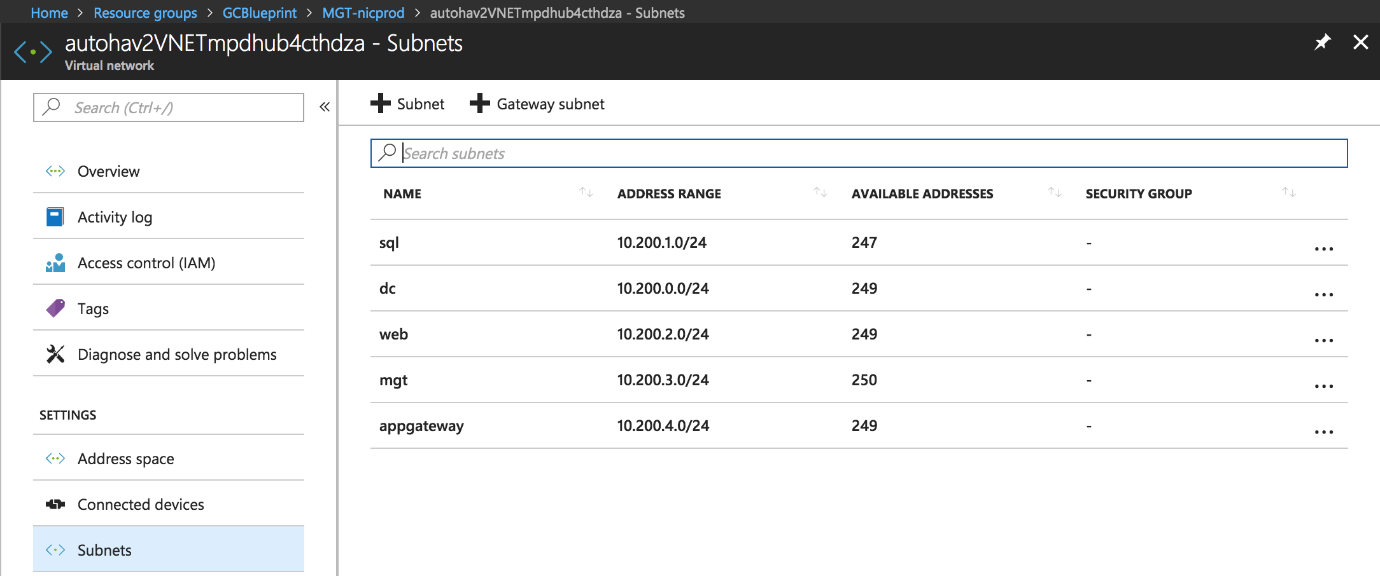
SC-7 (13) Isolation of Security Tools

Slide 9
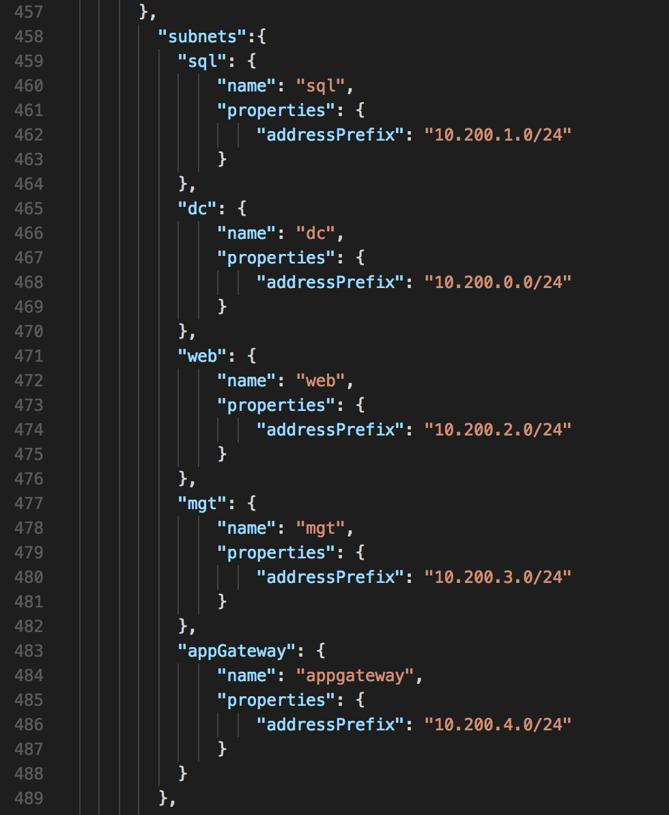
SC-7 (13) Isolation of Security Tools - 2
In the ARM Template
Azuredeploy01.json -> Calls the Nested Templates with more detail for provisioning and setup

Slide 10
SC-8 (1) Transmission Confidentiality

Slide 11
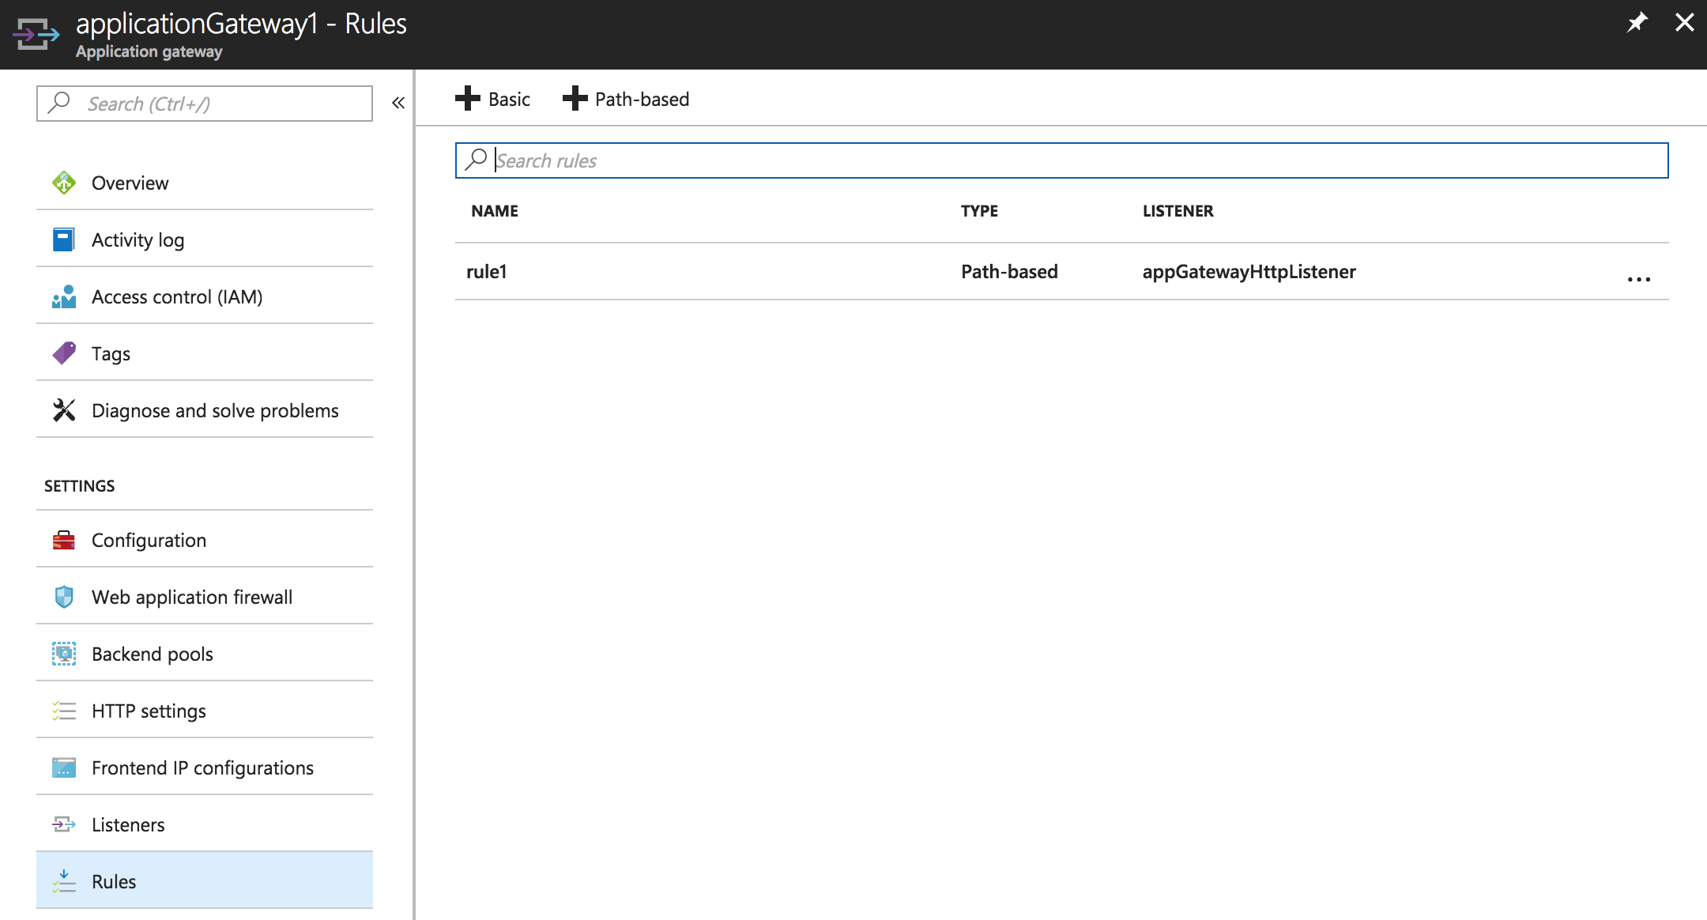
SC-8 (1) Transmission Confidentiality - 2

Slide 12
Demo

